Slide 1

AI BASED MENTAL WELLNESS APPLICATION
SANDRA S MENON
MCA B
ROLLNO : 39

Slide 2
Objective
The primary objective of this project is to develop an AI-powered web application that helps users track their mental wellness, analyze their moods, and provide personalized recommendations based on AI-driven analysis. The system aims to support users in improving their mental health by offering personalized content such as exercises, reading materials, meditation practices, and professional consultations.

Slide 3
EXISTING SYSTEM
1. Traditional Mental Health Support
2. Mental Health Applications
3. Online Therapy & Consultation Platforms.

Slide 4
PROPOSED SYSTEM
1. AI-Powered Mood Detection & Analysis
2. Personalized Recommendations
3. Weekly & Monthly Mental Health Progress Tracking
4. Admin Dashboard (For Student Monitoring)

Slide 5
MODULES
1. User Authentication & Profile Management
Allows users (students) and admins to register, login, and manage their profiles.
🔹 Features:
✅ Secure login & registration (JWT-based authentication).
✅ Profile management (name, email, contact details).
✅ Role-based access (Student/Admin).
✅ Data privacy settings (user can choose to delete data)

Slide 6
2. Mood Detection & Sentiment Analysis (AI Module)
AI-based module that detects the user’s mood based on text input.
🔹 Features:
✅ Users input their emotions via text selection.
✅ Sentiment Analysis (NLP) detects emotions (Happy, Stressed, Anxious, Depressed, Normal).
✅ AI assigns a Mood Score (low, normal, medium, high).
✅ Stores daily emotions in the database for tracking.

Slide 7
3. Personalized Recommendations & Solutions
Based on the detected mood, AI provides personalized recommendations for mental wellness.
🔹 Features:
✅ Exercise Recommendations (breathing exercises, meditation, yoga).
✅ Self-Help Articles & Reading Materials (stress management, self-care).
✅ Coping Strategies (daily wellness tips, affirmations).
✅ Expert Consultation Suggestion (if severe stress or depression is detected).

Slide 8
4. Mental Health Progress Tracking & Reports
Helps users track their emotional well-being over time using data visualization.
🔹 Features:
✅ Weekly & Monthly Mental Health Trends (graphs & statistics).
✅ AI-generated Mood Score History.
✅ Progress Level Assignment (Low, Normal, Medium, High).
✅ If negative trends persist, system alerts the user.

Slide 9
5. Admin Dashboard (Student Mental Health Monitoring)
Allows admins (counselors, mentors) to track students’ mental health
🔹 Features:
✅ View Student Progress Reports (weekly/monthly).
✅ Monitor High-Risk Students (alerts for low mental health progress).
✅ Send Notifications or Reminders to students.
✅ Schedule Consultation Sessions with experts.

Slide 10
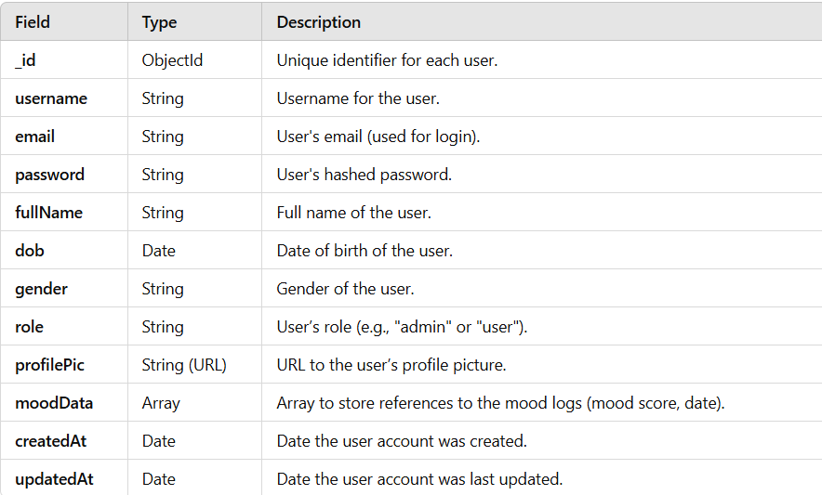
1. Users Table (Collection)

Slide 11
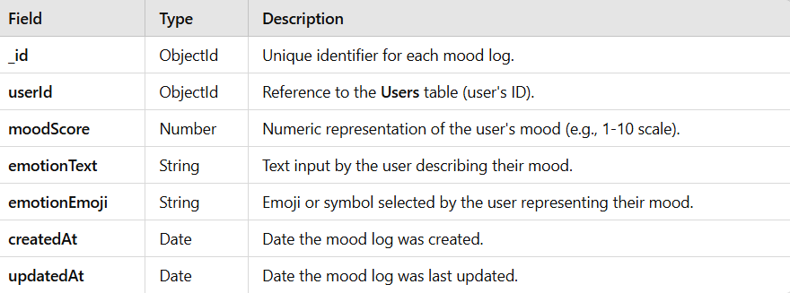
2. Mood Logs Table (Collection)

Slide 12
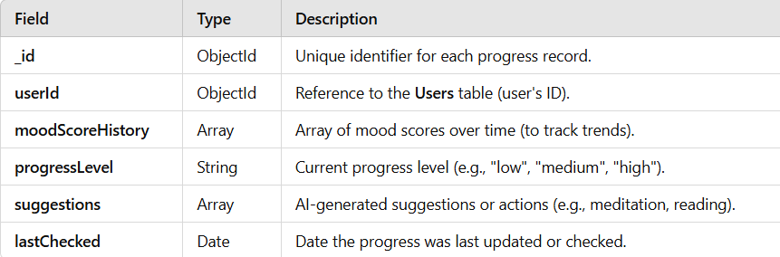
3. Progress Tracking Table (Collection)

Slide 13
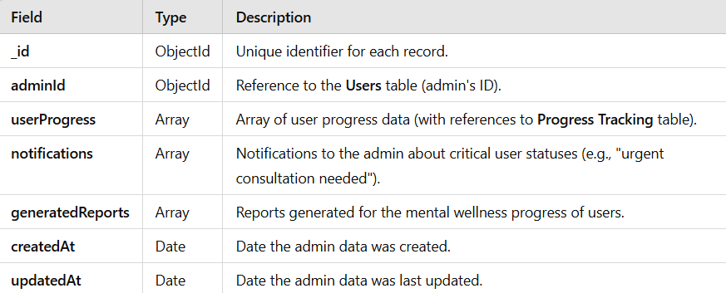
4. Admin Dashboard Table (Collection)

Slide 14
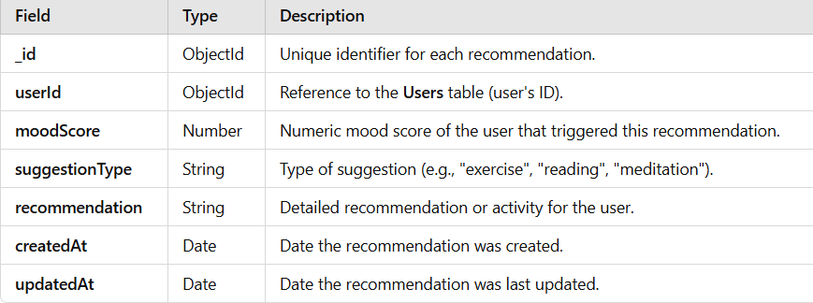
5. Recommendations Table (Collection)

Slide 15
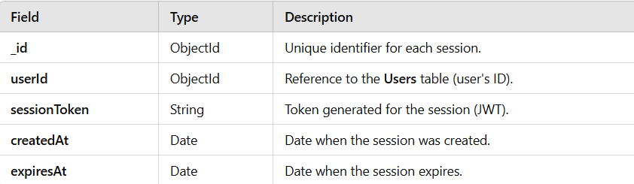
6. Sessions Table (Collection)

Slide 16
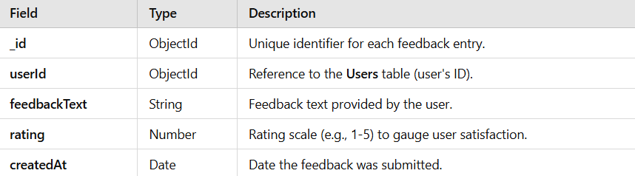
7. Feedback Table (Collection)

Slide 17
TOOLS
Frontend:
HTML
CSS
Bootstrap
JavaScript
React.js
Backend:
Node.js
Express.js
MongoDB (Database)
Mongoose

Slide 18
AI/ML:
Python
TensorFlow (for AI model development)
scikit-learn (for machine learning models)
NumPy and Pandas (for data manipulation)
Authentication:
JWT (JSON Web Tokens)
Bcrypt (for password hashing)

Slide 19
CURRENT STATUS
----> created a github repository
----> started the user login process

Slide 20
Thank you

